Slide 1
Data Analysis and Modelling of Shortlisting Dataset
Pranav Prabhat Sinha
RA2211047010105
SRM Institute Of Science and Technology Mobile number: 9324209869
Email: pranavindia071@gmail.com

Slide 2
Abstract
Preliminary exploration of a dataset comprising 810 entries and 19 columns reveals its structure and statistical properties without any missing values.
The relationship between income brackets and the percentage of household income invested is investigated, revealing investment patterns across demographics and roles, with Marketing and Sales Executives yielding the highest returns.
Various attributes are analyzed for their correlation with 'Return Earned,' using a Random Forest Classifier among other models to predict investment returns.
Model performance significantly improves by focusing on attributes with a high correlation to 'Return Earned,' such as city, role, and reasons for investment, with the Random Forest Classifier achieving an accuracy of 83%.
Model using neural network analyzing risk and knowledge about the market gave 94% accuracy
Tested both Return Earned and Risk Model, achieved good accuracy between train and test data

Slide 3
methodology
Data Exploration
Demographic Analysis
Employment Details
Investment Behavior Insights
Correlation Analysis
Predictive Modeling
Model Testing and Validation
Model Evaluation

Slide 4
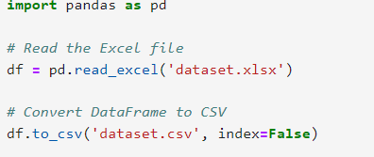
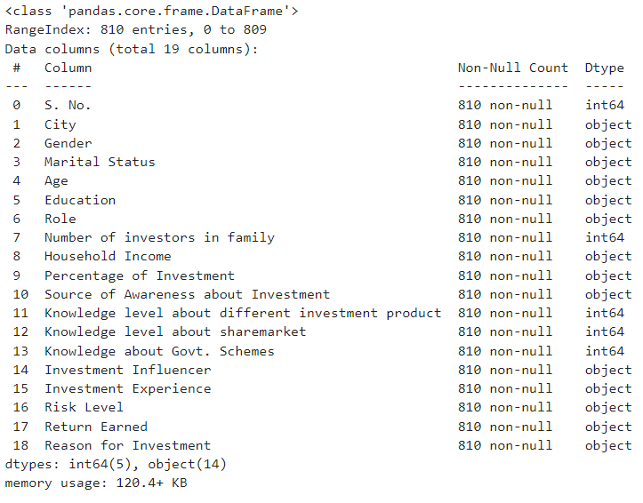
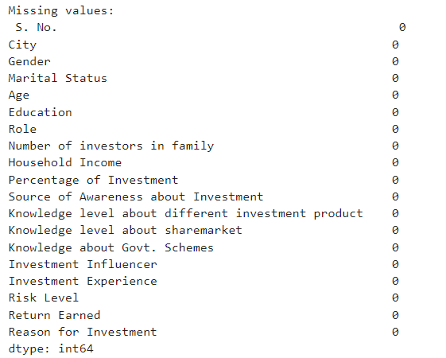
Data Exploration
The data is loaded into a pandas Data Frame from an Excel file and converted to a CSV format.
The Data Frame is inspected using the. head(), .info(), and .describe() methods to understand the structure and statistical summary of the dataset, which includes 810 entries across 19 columns
No missing values are reported in the dataset.

Slide 5
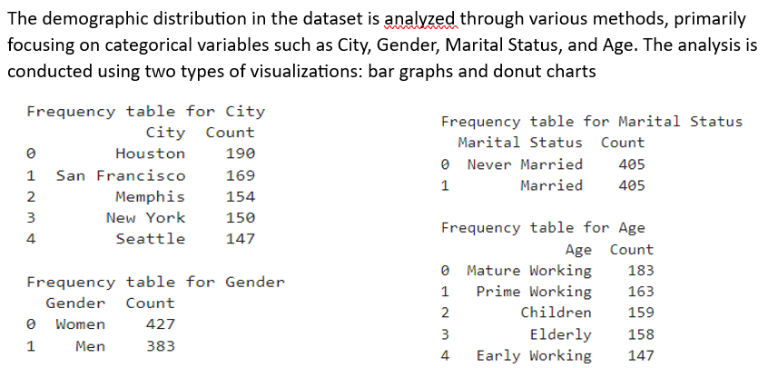
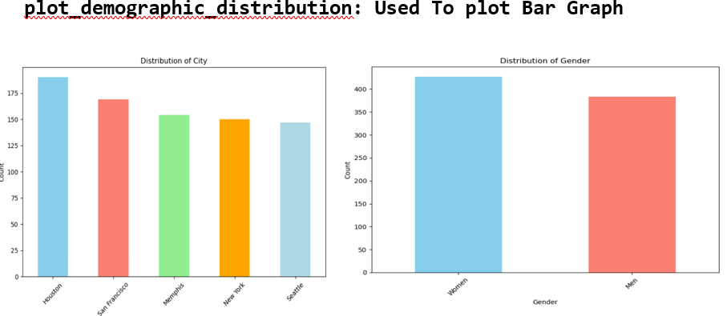
Demographic Analysis

Slide 6
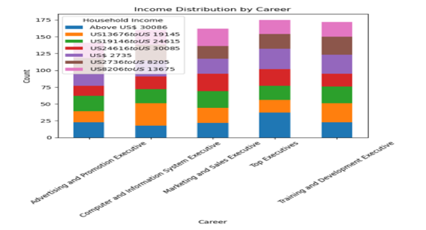
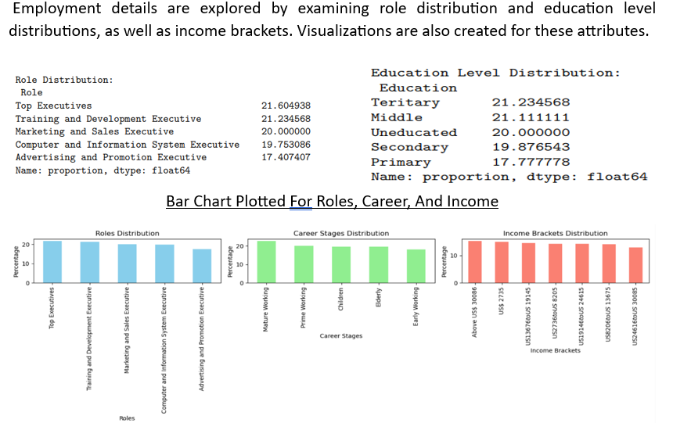
Employment Details
The 'Percentage of Investment' variable is analyzed about Household Income. This analysis reveals how much of their income individuals in different income brackets are investing.
Some individuals choose not to reveal their investment percentage, while others invest various proportions of their income, ranging from Up to 5% to Above 26%.

Slide 7
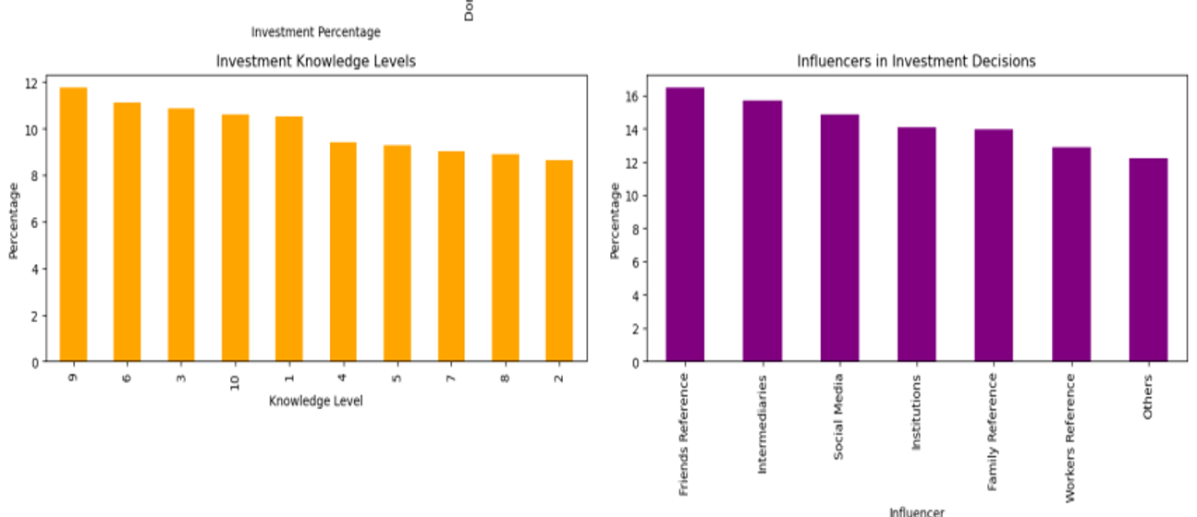
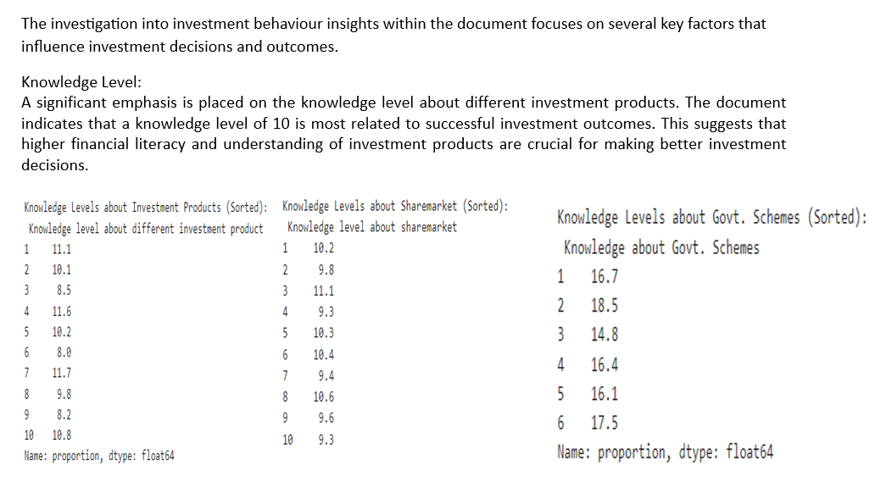
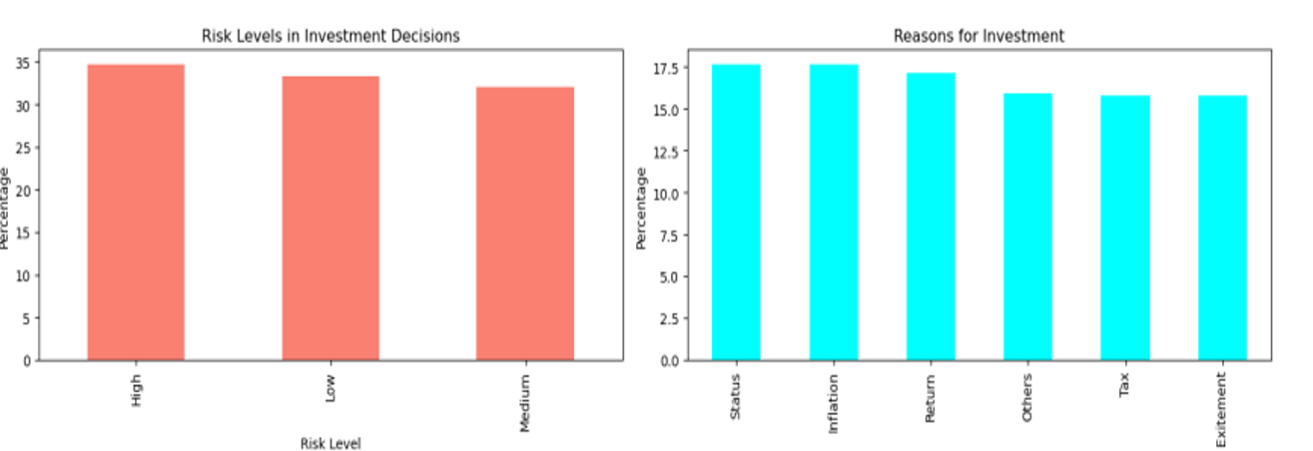
Investment Behavior
Source of Awareness
Investment Influencers and Experience
Reasons for Investment
Percentage of Household Income Invested

Slide 8
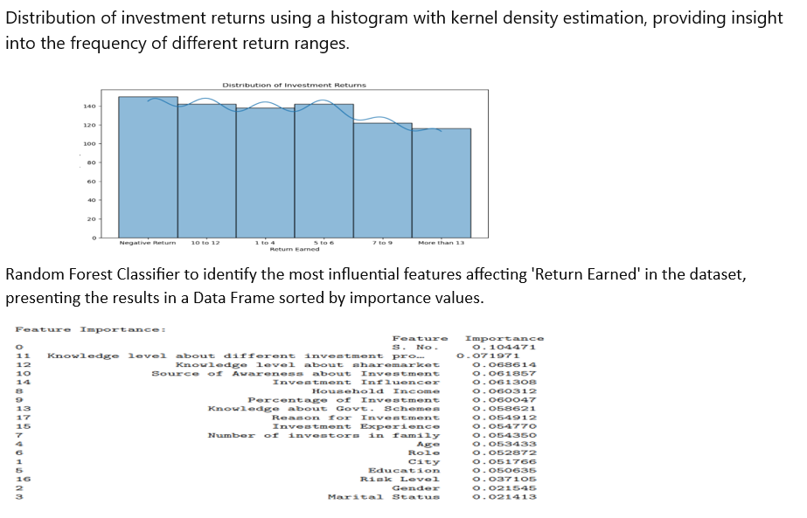
Importance Analysis

Slide 9
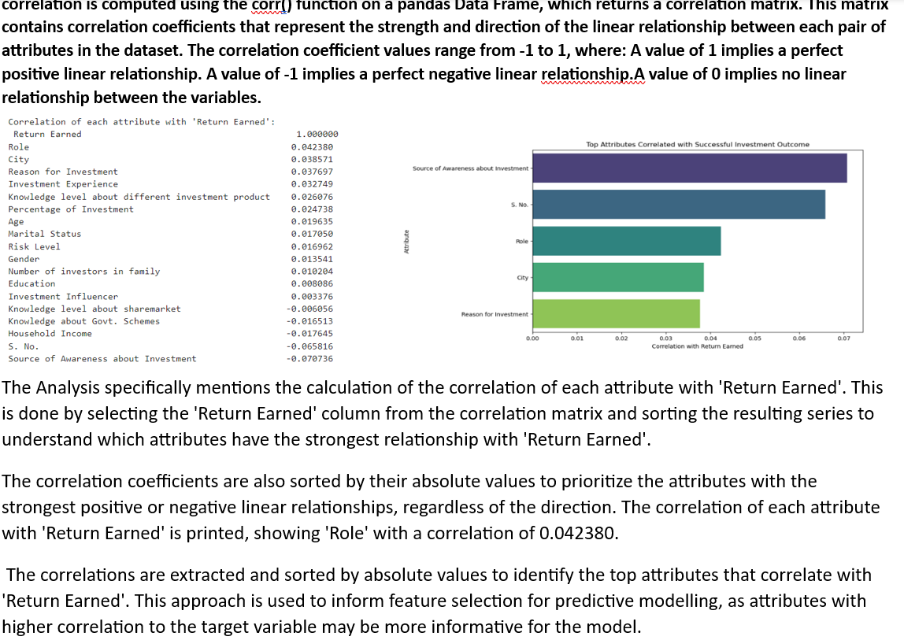
Correlation Analysis

Slide 10
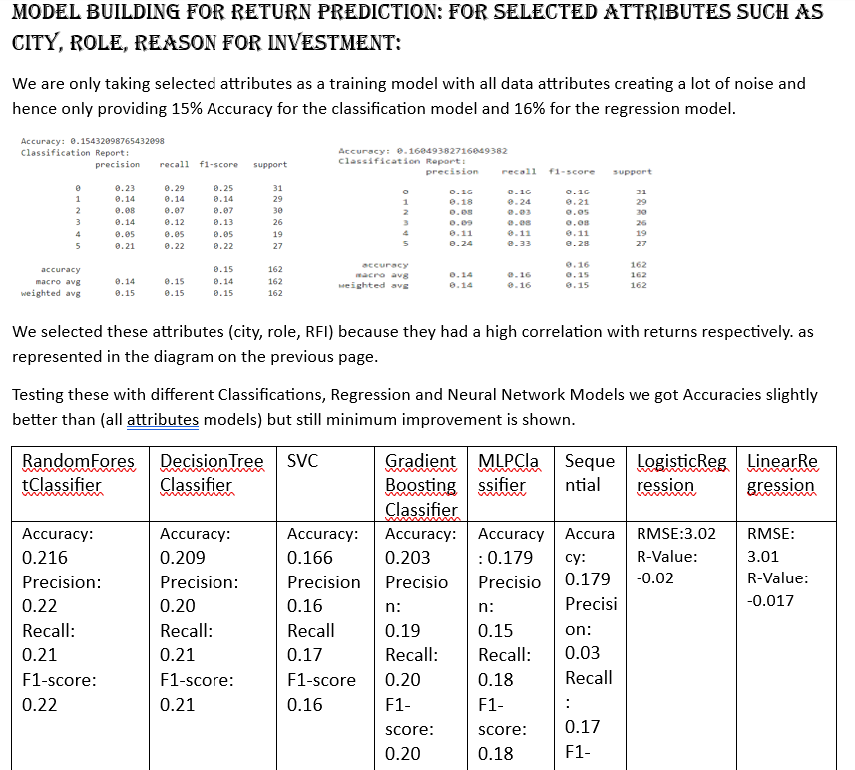
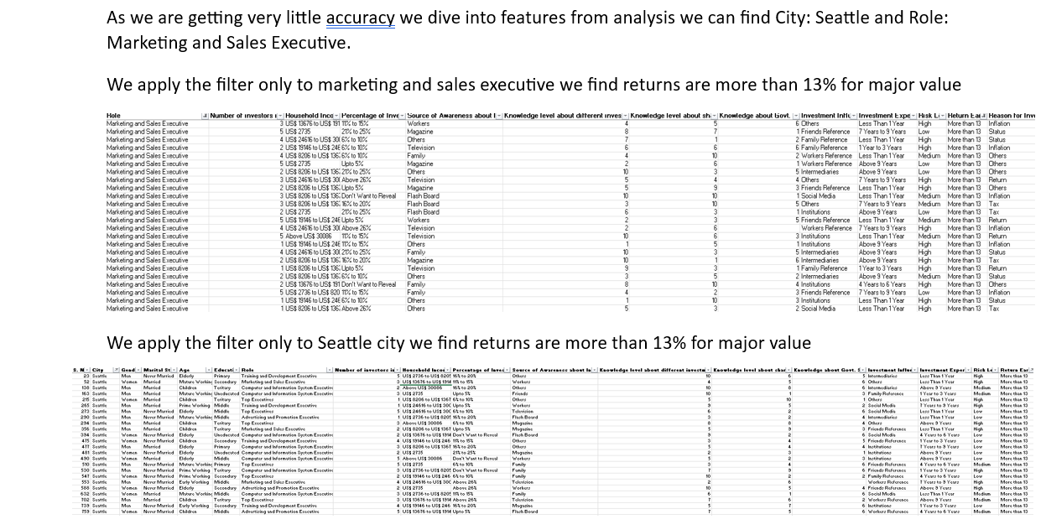
Predictive Modelling: Returns

Slide 11
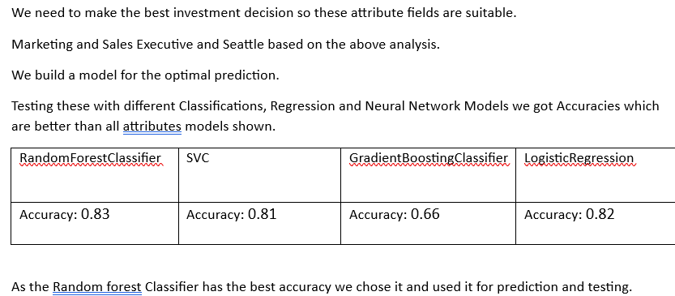
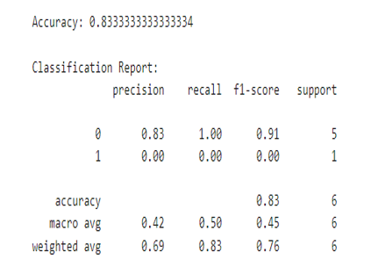
Model training: Returns
This code loads a dataset and filters it for individuals in Seattle city with a role of Marketing and Sales Executive. It then prepares the features and target variable, encodes categorical variables, and splits the data into training and testing sets. A Random Forest Classifier is trained on the training data, and predictions are made on the test set. Finally, the model's accuracy and classification report are printed to evaluate its performance in predicting high returns ('More than 13').
We got an Accuracy of 83.33% which is a decent accuracy for building a model.

Slide 12
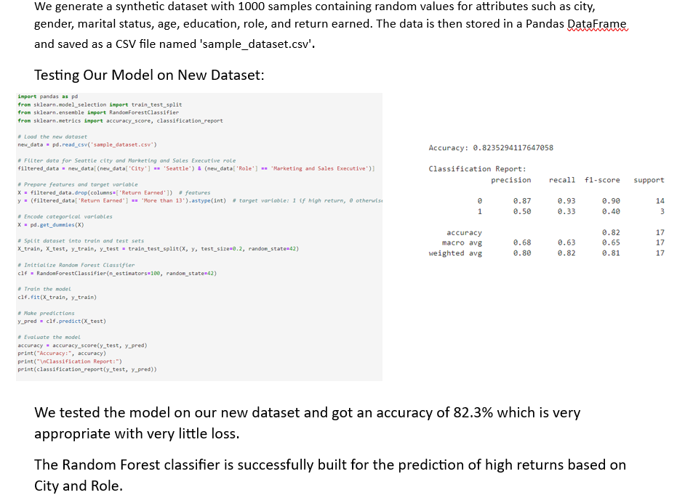
Model Evaluation: RETURNS

Slide 13
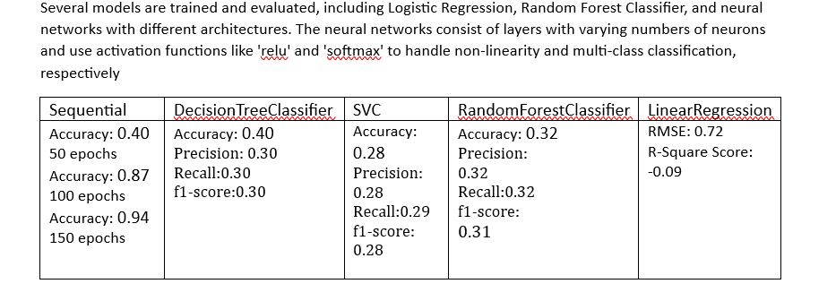
Predictive Modelling: Risk

Slide 14
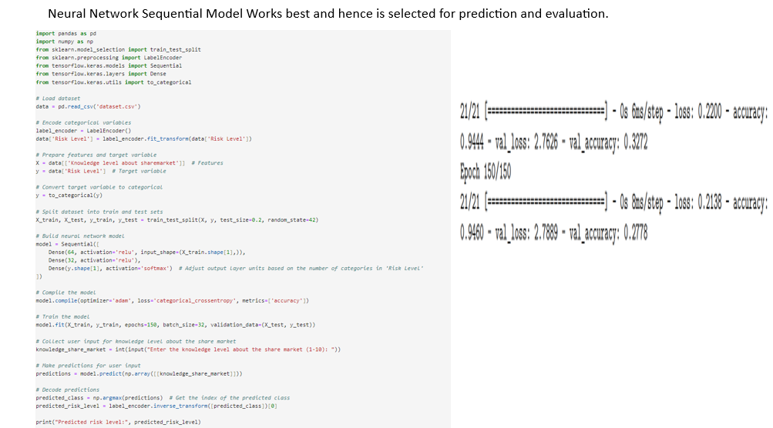
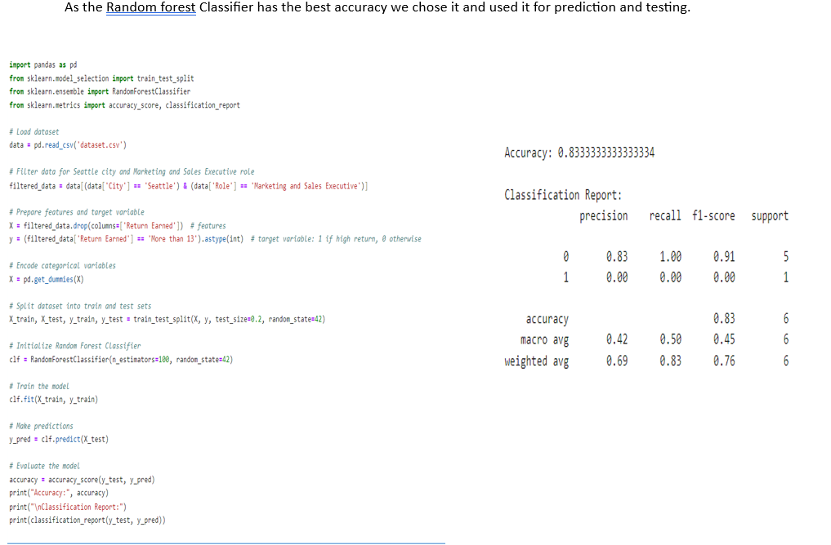
Model training: Returns
The Accuracy of the Model is 94.6%.
This code loads a dataset from a CSV file and preprocesses it by encoding categorical variables using LabelEncoder. It then splits the dataset into training and testing sets. Next, it builds a neural network model with three dense layers, using rectified linear unit (ReLU) activation for hidden layers and softmax activation for the output layer. The model is compiled with the Adam optimizer and categorical cross-entropy loss function.

Slide 15
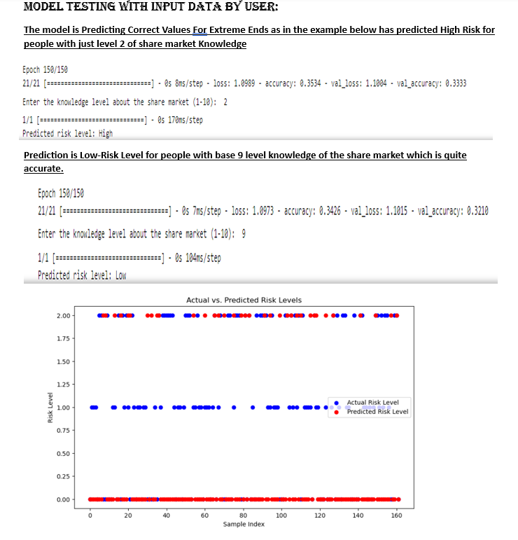
Model testing: Returns

Slide 16
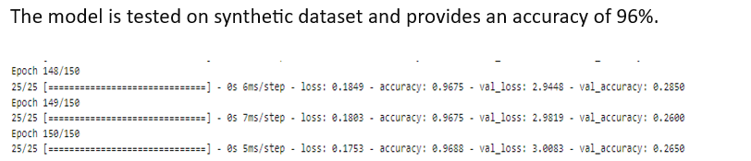
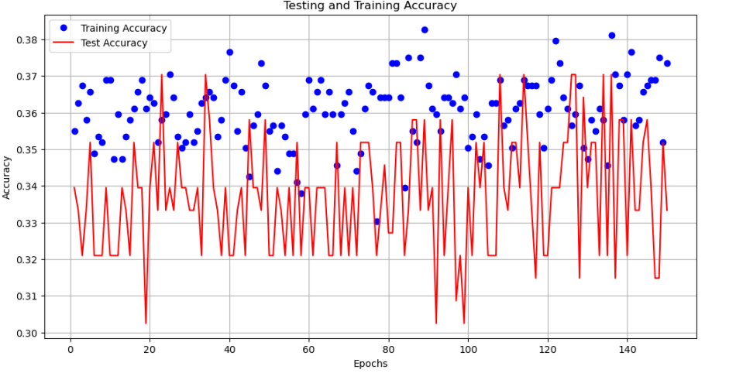
Model Evaluation
This Python code generates a synthetic dataset with 1000 rows and various attributes using NumPy and Pandas. Attributes include demographics, financial information, investment details, and risk levels, with options predefined for each attribute. The dataset is stored in a Pandas DataFrame and then saved to a CSV file named 'synthetic_dataset.csv'. Finally, the first few rows of the dataset are displayed using the head() function to verify its structure.
The Testing and Training dataset shows the same level of accuracy 96 and 95 percent respectively with weak positive correlation.

Slide 17
Potential Areas for improvements
Feature Engineering
Model Optimization.
Longitudinal Studies.
Risk Prediction.
Investment Behavior Analysis.
Demographic and Employment Analysis.
Algorithmic Fairness and Bias

Slide 18
FUTURE WORK
Application of Deep Learning
Analysis of Time-based Data
Applying these Models to other datasets related to money management
Try this model with more attributes and features

